Slide 1
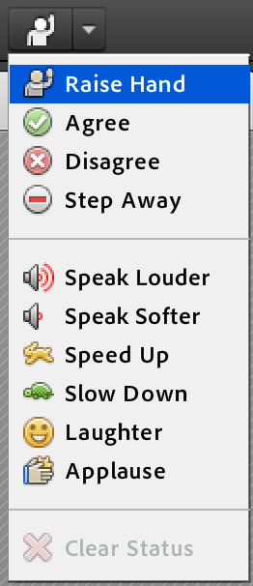
±5 Ways To Make Engaging Flipping Videos by Jonathan Thomas-Palmer
While we are waiting to start, please familiarize yourself with the webinar tools. For example, you can raise your hand, agree, applaud, laugh, etc. and then, when your laughter has abated from guffaw to titter, please answer the survey question.
Scheduled start time: Wednesday, June 25th @ 8:30 AM EST
Presenter Info:
flippingphysics.com @flippingphysics jon@flippingphysics.com
Notes:
To do / have ready for the 4T2014 Webinar:
Resize screen to normal size.
Google Analytics, Google Drive, Weebly & WatchKnowLearn open in Safari
Turn off notifications
Turn off screen saver
Turn off Energy Saver
Turn off noisy things in the house
pause backblaze
Survey starts with A-E
Use kate’s computer
Screen capture both computers (start 15 minute early)
External Microphones (start 15 minutes early)
External Video Camera, use miniDV and start 1 minute before.
Turn off mic when I am not speaking!

Slide 2
Jonathan Thomas-Palmer
13 year High School Physics teacher
College Prep Physics
AP Physics C: Mechanics
AP Physics C: Electricity & Magnetism
Flipping Physics®
⤷ Free Physics Educational Videos

Slide 3
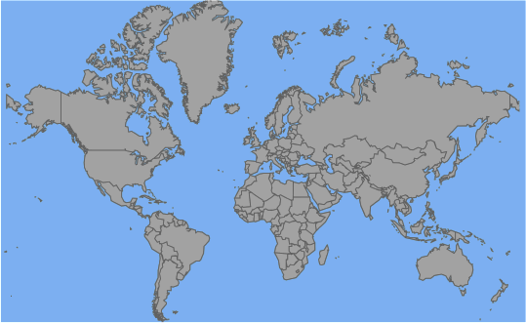
The Geographic Location Survey!
a.k.a. “Can I find you on planet Earth?”

Slide 4
The Geographic Location Survey!
a.k.a. “Can I find you on planet Earth?”
When the link appears in the chat, click on it. It should open up in your default web browser. Leave the browser open and come right back here to the Webinar.
Notes:
While they are going to the webpage:
Switch to the next slide.
Go to Safari and zoom in on the map of the united states.
Go back to Adobe.

Slide 5
The Geographic Location Survey!
Now that you are back from the webpage. If you could please “Raise Your Hand” to let me know that you are back.

Slide 6
We are all here to …
discuss how to make engaging flipping videos
be supportive of one another.
ask & answer questions.
give suggestions & be involved.
www.flippingphysics.com/flipcon14.html

Slide 7
Survey Results
How much time do you spend, on average, making flipping videos per week?
1) 0 – 0.5 hours
2) 0.6 – 1.0 hours
3) 1.6 – 2.0 hours
4) 2.1 – 3.0 hours
5) 3.0 - 168 hours

Slide 8
Today’s Webinar Outline:
The Basics
List of “Don’ts”
List of “Do’s”
You get to vote!
Your Suggestions.
[this is not a basic “how to” webinar]

Slide 9
The Basics:
Before you start filming:
Turn off your mobile phone.
Listen for extraneous noises.
Re-check all your equipment.
Is everything recording?

Slide 10
The Basics:
Live video or Picture-in-Picture
Look in a mirror. (Derek Muller)
Think about the video background.
(no bright lights, including a window)
Center yourself.
Remain rather stationary.
Use Text and Equations.
Big Text & Drop Shadow

Slide 11
The Basics:
Video Length:
Jon Bergman, “My rule of thumb is one to 1½ minutes per grade level.”
Flipping Physics’ Suggestion?
I don’t have one.
One of my most watched videos is 63 minutes.
One of my most viewed videos is 59 seconds.
You know your students and subject material.

Slide 12
My List of Don’ts
Don’t use your built in microphone.
Paul Anderson of Bozeman Biology uses “Samson Go Mic Compact USB Microphone - Plug n' Play”
It’s about $40
Don’t ignore Audio Levels.
Don’t be just a Talking Head.
Hold pertinent items
Point at parts of the presentation

Slide 13
My List of Don’ts
Don’t cut the video mid-sentence.
Don’t overuse transitions and effects.
Don’t go on at length without any visual change.
Add text or graphics
Don’t film outside (if you want to hear dialogue.)
wind and extraneous noises
Don’t have continuous background music.

Slide 14
Opine about Don’ts!
When the link appears in the chat, click on it. It should open up in your default web browser. Rate each of my suggestions from 1 – 5.
1 – Not Important
2 – A little Important
3 – Important
4 – Very Important
5 – Extremely Important
(come back here when done & follow instructions.)
Notes:
While they are going to the webpage:
Switch to the next slide.
Go to Safari and zoom in on the map of the united states.
Go back to Adobe.

Slide 15
Welcome Back!
Now that you are back, please “raise your hand” to let me know you are back.

Slide 16
My List of Do’s
Enjoy yourself.
Look at the Video Camera!
Collaborate.
Colleagues and Students.
Be Creative.
Avalanche Effect
iPhone App - Action Movie FX (free)
My children

Slide 17
My List of Do’s
Provide Lecture Notes.
Have a theme.
Every 10 videos or so …
Use A Script.
Make Mistakes / Address Misconceptions
Fast-Forward when necessary
Saved 50 seconds → 3 classes of 30 students over 10 years saves 45,000 seconds or 12.5 hours.

Slide 18
Opine!
When the link appears in the chat, click on it. It should open up in your default web browser. Rate each of my suggestions from 1 – 5.
1 – Not Important
2 – A little Important
3 – Important
4 – Very Important
5 – Extremely Important
(come back here when done & follow instructions.)
Notes:
While they are going to the webpage:
Switch to the next slide.
Go to Safari and zoom in on the map of the united states.
Go back to Adobe.

Slide 19
Your Suggestions!
Now that you are back, please take the time to add your suggestions to the “Chat” pod.
Once you are done, please “raise your hand” to let me know you are done.

Slide 20
Thank You!
Jonathan Thomas-Palmer
www.flippingphysics.com
@flippingphysics
jon@flippingphysics.com
FlipCon14
2014.06.25

